Slide 1
Lexus Customer Master Database (LCM DB)
Group 3
Abhinav Sathyanarayana Rao
Jainil Malaviya
Nitya Patel
Saahil Karnik
Sujiitra Murukeshan
Vedant Rajesh Ukirde

Slide 2
Outline
We are going to present the Lexus Customer Master Database system, which has a lot of robust and productive features as follows:
Provides a 360-degree view of customer and vehicle relationship.
Provides intelligent insights for the business.

Slide 3
Executive Summary
Though Lexus has a lot of advanced systems, none provide customer-centric solutions which track the customer-vehicle relationship since inception.
Our proposal provides efficient cum insightful solutions which help to manage the relationship with customers throughout and also highlight the process gaps.

Slide 4
Initial Phase
Collect Requirement
By collaborating with current customers and relevant stakeholders, we documented the most common concerns and expected features.
Conceptual Modelling
Cognitive perception of the data and its related processes.
Logical Modelling
Clear pictorial representation of the data with all its child elements and high-level functionality.
Physical Database Design
ERD-based development of the database which comprises the table columns with involved intricacies.

Slide 5
Designing Phase
Primarily involved in designing the system with 3 core components which interact with each other resulting in child elements.
Customer
Vehicle
Dealer
Using these core and child entities, we normalized the flow of data and designed the Entity Relationship Diagram.

Slide 6
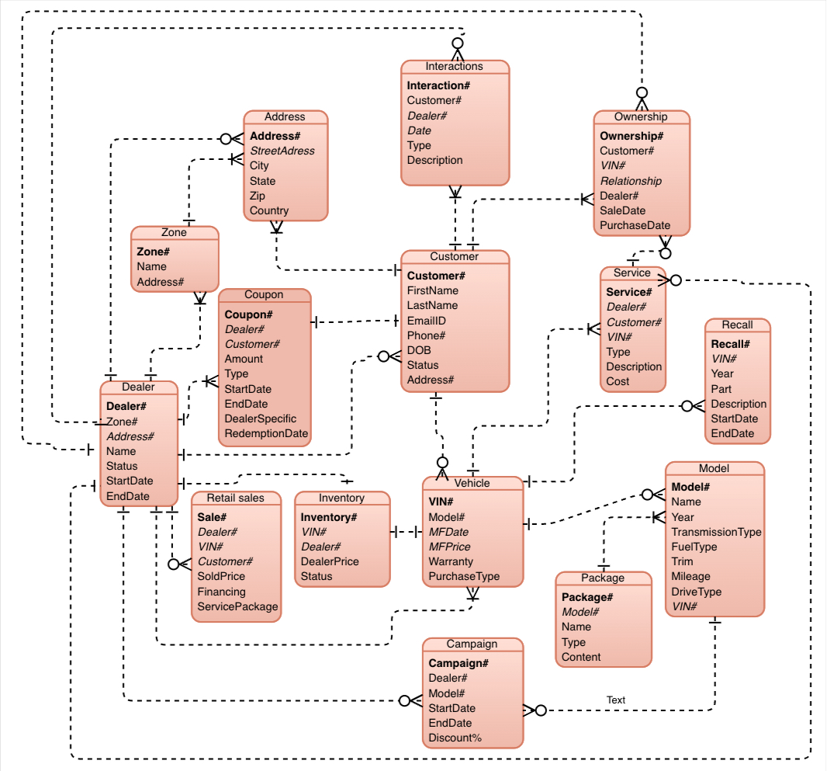
ER Diagram

Slide 7
Physical Schema
The most important entities and their attributes are:
Customer- Customer#, name, address, email, contact information
Vehicle- Vin#, MF Date, MF price, Warranty
Dealers- Dealer#, Dealership status, start and end date
Retail Sale- Dealer#, Customer#, VIN#, Sold price
Model- Model#, transmission type, drive type
Campaign- Model#, discount%, campaign duration
Service- Customer#, service type, cost

Slide 8
Business Rules
There are a few basic requirements provided by the business which we consider to be our business rules, which are as follows:
A customer can be an owner or a potential customer.
A dealer has an inventory of the vehicles.
Both dealer and customer have their addresses together as one.
Dealers can be in different zones.
One owner can have more than one service.
A customer and vehicle will be related to each other only via ownership data.

Slide 9
Continued
A vehicle can be related to multiple ownerships both past and present.
A vehicle can have more than one recall.
A vehicle can have more than one model.
A model can have more than one package.
A customer can have more than one interaction with the dealer.
A dealer can do more than one campaign.
A dealer can give more than one coupon to the customer.

Slide 10
Constraints
Based on the business rules, we need to have a few constraints, the most important constraints are as follows:
Primary Keys: Customer#, Dealer#, Vin#, Model#, Sales#
Foreign Keys: Customer#, Dealer#, Vin#, Model#, Sales#
Here, we can see that both the primary key and the foreign key are derived from the same attribute. This proves the weight that these attributes carry in the database.

Slide 11
Application
Any car manufacturer could use this application to store the details of customers, owners, vehicle inventory, and dealers.
Aids the manufacturer in visualizing vehicle sales and recalls performed.
Helps provide insights to generate remainders for the upcoming vehicle services based on the past data.
Helps dealers to generate campaigns based on current sales and inventory.

Slide 12
Identify Market Trends
With the vehicle models and their respective sales data, we get insights into the market trends and the best-selling models, which aids in planning and innovations in the same model.

Slide 13
Sales & Service Expansion
With the region-wise sales report data, we can proactively find the hotspots and establish more servicing dealers.
Also, with the same data, we can find the regions which have very low sales, based on which we can provision more accessible dealers who provide tailored customer service.

Slide 14
Quality Assurance
Have periodic reports on recalls that help to identify the flaws and resolve them to provide more quality products with superior safety.

Slide 15
Financial Gain
With this database, the customer’s requirements and concerns can be analyzed and easily addressed.
Providing a quality product based on the needs with a more tailored experience would improve the business.
This assures increasing profitability.

Slide 16
Summary
So, with this intuitive LCMDB, Lexus would have the cutting-edge expertise to take a lot of calculated ventures.
It endears the customers and dealers.
It ensures that there are no data gaps and keeps track of all the processes involved in this.

